Slide 1
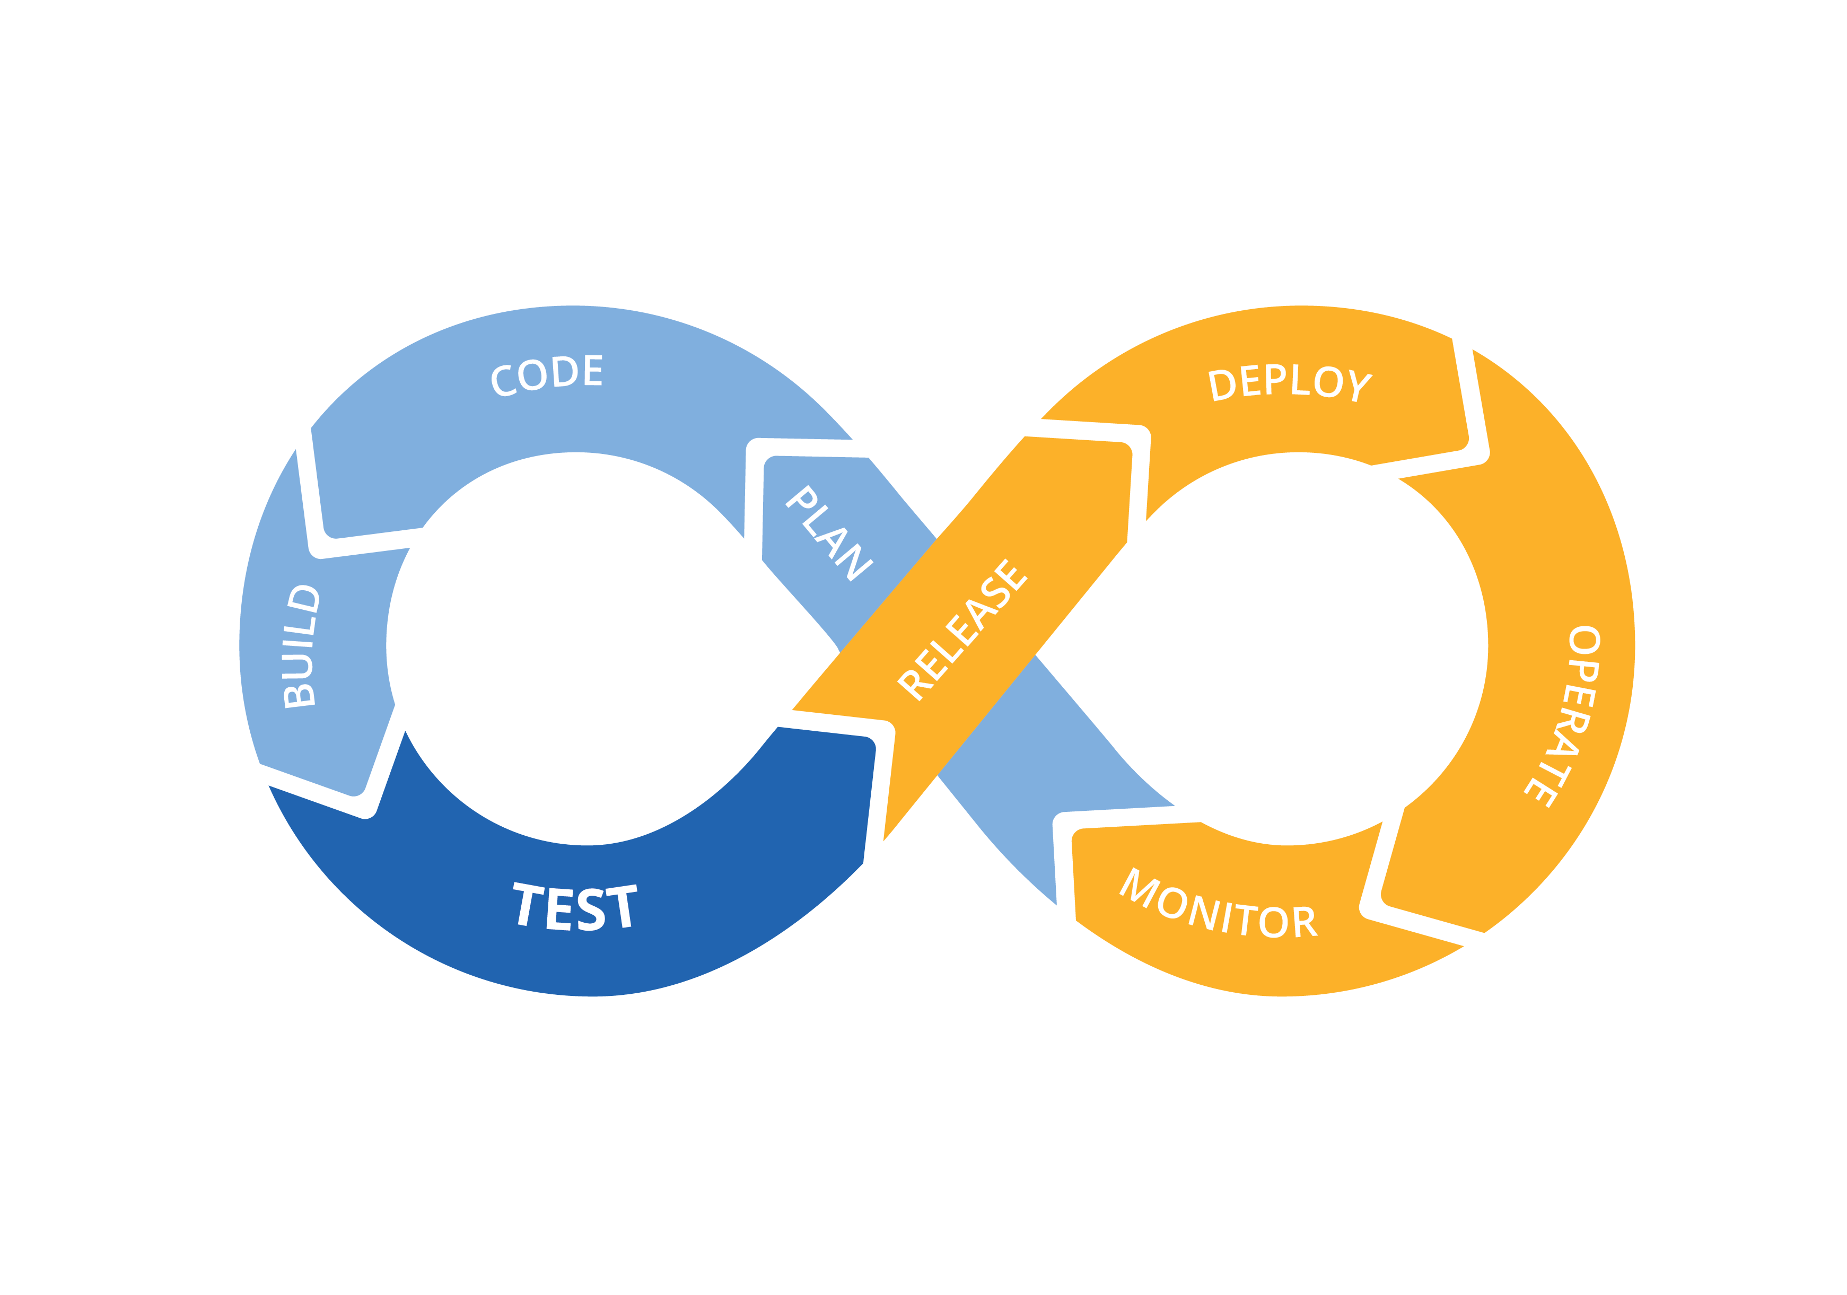
Weekly Review
10th June 2024 - 15th June 2024
Presented BY
Sreejitha .c
EMP ID: TYP2721

Slide 2
THIS WEEK PROGRESS
Subject: AWS
TOPICS | SELF PRESENTATION | GUIDED PRESENTATION | FEEDBACK
Global Infrastructure | Yes | Yes | Approved
Top Services in AWS and AWS console | Yes | Yes | Approved
Introduction to EC2 and its components | Yes | Yes | Approved
Hands on EC2 and its components | Yes | Yes | Approved
S3 | Yes | Yes | Approved

Slide 3
TASK DONE IN THIS WEEK…
Attended KT on GIT.
Evening batches on AWS from 7pm to 9pm.
Assessment on GIT and AWS
Assessment on GIT

Slide 4
Targets for coming week
Giving presentation on below AWS topics:
IAM
VPC
Taking presentation of Mahima on GIT.
Doing R&D on AWS.

Slide 5
Thank you

